Slide 1
Konnex

Slide 2
Team Name - Script Kiddies
Mehul Agrawal
Shivam Tiwari
Suyog Bhat
Harsh Gautam
Ajay Singh Deopa
Theme - Konnex

Slide 3
Problem Statement
When user surf the web there is probability that user got stuck at a point completely clueless, this could happen due to lack of user awareness or unclear design of website.a
Konnex is developed to enhance user experience on any website. It is an application that integrates the end to end user experience and application support into one single place, which is accessible as an onscreen floating widget on top of any webpage.

Slide 4
Solution
Our Idea is based on creating a whole community where one user can solve the questions asked by another user for a specific website/application, just like the stackoverflow and quora community.
This will improve the user experience of a user visiting any website on the internet, because with our application user has the power of community at his disposal, using the very user friendly floating widget we have developed.
To measure the impact of solution we have introduced gamification feature in the project, which is whenever a user contributes to the community by answering questions, his score increments. By the scores we can see impact and user engagement.
Frameworks and tools – Backend is a REST service developed in Spring Boot, User Interface is Floating widget which in turn is a Chrome Extension developed using Javascript & the Console for companies is a website developed using HTML, CSS, JavaScript, Bootstrap.
Reason behind choosing Spring Boot is because of its robust design pattern and inbuilt security modules & reason for choosing chrome extension is for the creating the floating effect on top of any website.
Our Solution is easily implementable because it is based on a simple but very powerful concept of community.
The Idea is scalable to support all websites, because of its methodology to solve a user problem.

Slide 5
Methodology
Our Project has 2 Interfaces :-
Console for Companies
The features include –
Access FAQs for their domain
Access Bug reports for their domain
Add Page suggestions/Announcements
Floating Widget for Users
The features include –
Ask Anything Box
Kobot (Konnex Chatbot)
Bug reporting
User Scores for gamification
Page Suggestions (Announcements)
Documentation on the repo –
https://github.com/Mehulagrawal710/Script-Kiddies-Airbus-Aerothon -> documentation of the project folder

Slide 6
Working Prototype
Link to video of working Demo of the Project-
https://drive.google.com/file/d/1lMm-2N9jUHxRgqchjz7hKzGLxIGXB3SG/view?usp=sharing
This video of working demo explains the project, the structure, the concepts, the Idea and the working demo.
We request please watch this complete video so you could also connect with the idea we have thought, We strongly believe this has the potential to become a mainstream application.

Slide 7
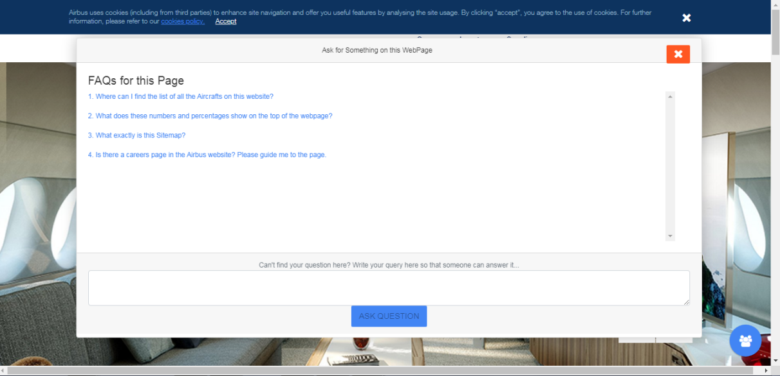
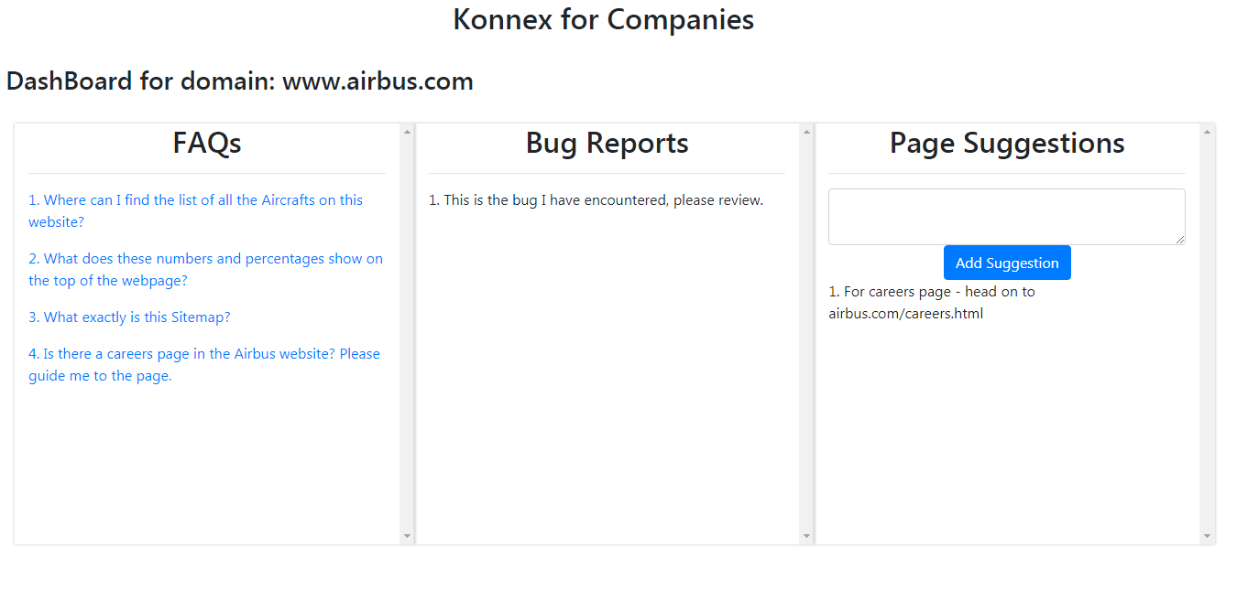
Attachments
Floating Widget – Browser extension
Console for Companies

Slide 8
ThankYou

